Slide 1
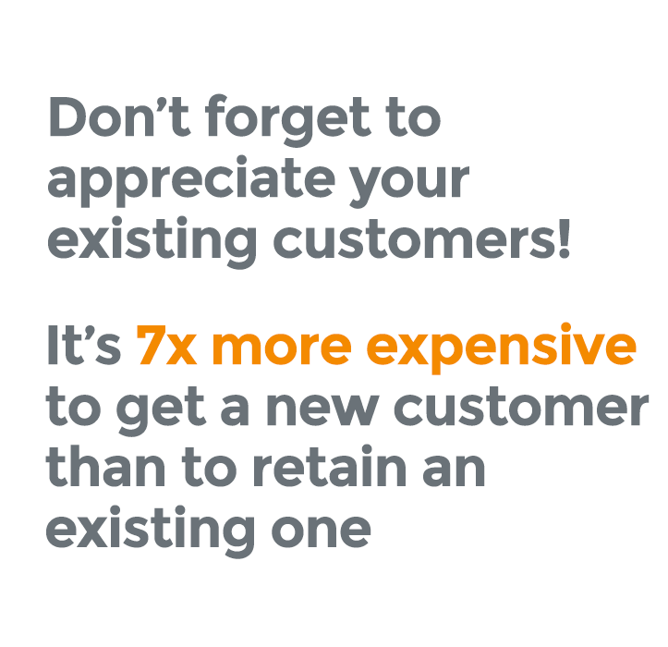
Akamai Perks
LOYALTY REWARDS PROGRAM
Smartest Way to Gain & Retain Customers
Reward Kiosk ▪ NFC Mobile Punch Card
www.akamaiperks.com

Slide 2
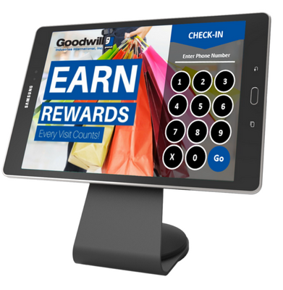
Reward Kiosk
Digital Punch Card
Custom designed
Easy for customer, no effort by staff
Tablet, stand custom app all included
Collect your customers special dates such as birthdates and email addresses
Your customer simply enters their phone number into the Reward Kiosk. All visits are recorded and managed.
www.akamaiperks.com

Slide 3
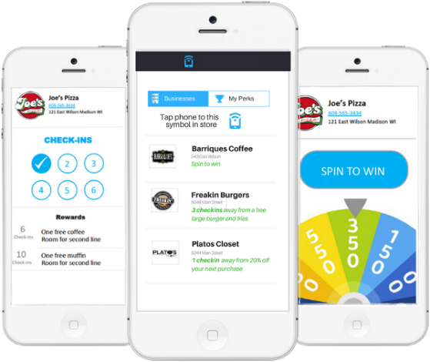
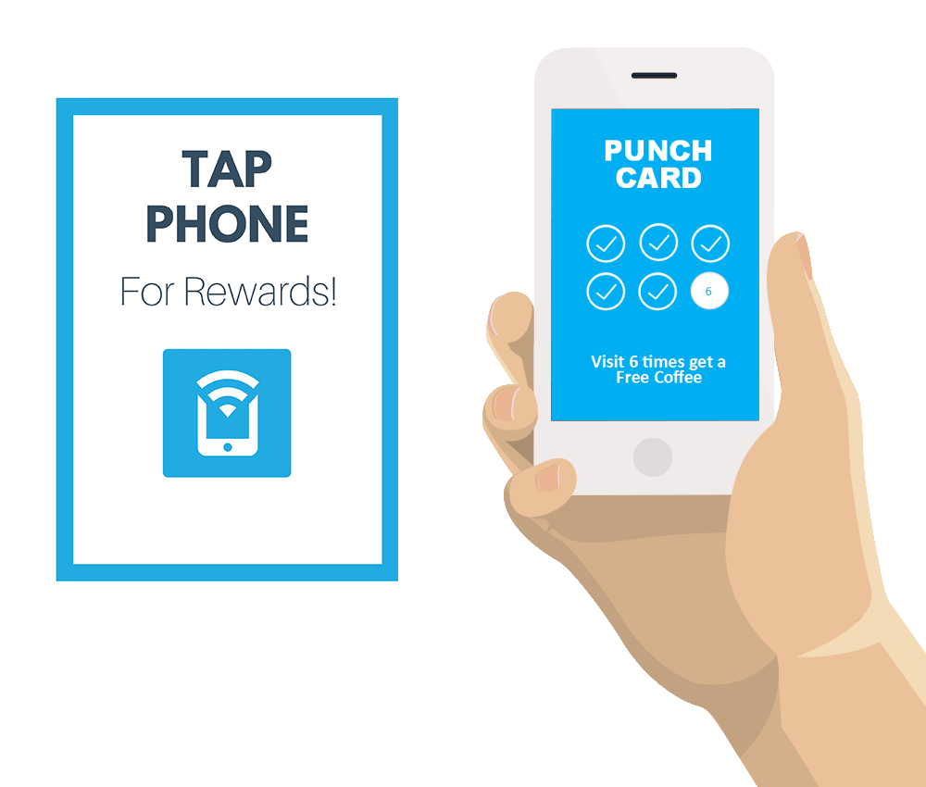
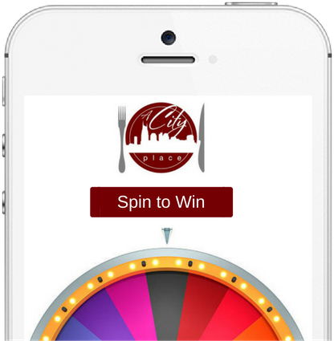
Akamai Perks
LOYALTY REWARDS PROGRAM
NFC Mobile Punch Card
Consumers can manage all their rewards on one app.
Reward your customers from their
Visits simply by having them tap their
Phone on counter display
Run Spin to Win Game to reward
‘winner’ with offers.
www.akamaiperks.com

Slide 4
Auto-Pilot Engagement
Sample Texts
We Miss You Texts
Birthday program
Social media texts
Any messages at pre-defined points
Mass Text Broadcast
Text blast all subscribers
Messages or offers
Schedule texts to send later date
www.akamaiperks.com

Slide 5
Benefits of our system
Digital Loyalty + Text Marketing- 99% OPEN RATE
Auto-pilot Text Messages
Drive customers in with subscriber text blast
Customized design and program to your business
No effort by staff
Grow social media followers and reviews
www.akamaiperks.com

Slide 6
Spin to Win Game to win rewards
Retain by rewarding customers number of visits to business
Special occasion reminders such as birthdays to reward your customers
Mobile deals on their phone
Geo Fencing alerts customers about special deals when within the area.
Have a loyalty rewards program at a fraction of the costs that big business invest in!
www.akamaiperks.com

Slide 7
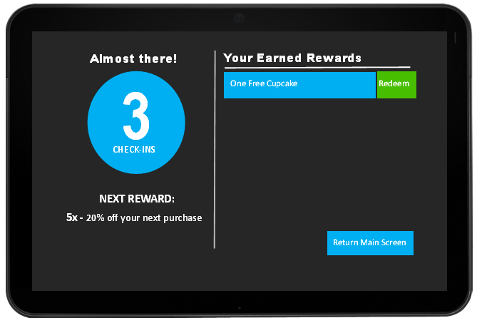
Rewards & Redemption
Customers always see their rewards
Mass text offers display in rewards
Discount button automatic on tablet
Rotate tablet or show text to redeem
www.akamaiperks.com

Slide 8
Analytics & Reporting
Run date ranges of all data
Details for auto-pilots and broadcasts
Weekly and monthly email
Tracks all rewards earned and redeemed
www.akamaiperks.com

Slide 9
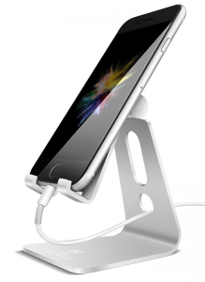
Requirements
Kiosk: Table & Stand
WI-FI in place of business required
Android 9” Tablet (can be pre-owned) - $80 Used
Tablet Stand - $15
NFC Tag:
NFC Tag is not required if doing the Kiosk system
We’ll provide you with the NFC Tag and Stand
Your customer needs to download app to their phone. Need to create an incentive to download the app by giving them something for free on the initial sign up.
www.akamaiperks.com

Slide 10
PACKAGE PRICING
HOWZIT PLAN
PONO PLAN
SHAKA PLAN
$249/mo
$149/mo
$199/mo
Up to 250 Subscribers
500 Texts/mo
Up to1000 Subscribers
2000 Texts/mo
1000+ Subscribers
2000 Texts/mo
Tablet & Stand
Auto-pilot Text Engagement
Loyalty Punch Card Kiosk
Text Broadcasts
Custom Designed App & Program
Ongoing support and training
Setup Fee $199 - All prices per location. $.05 per Text over minimum plan.
*Purchase of Tablet & Stand: Price Range of $70-90 sold separately
www.akamaiperks.com

